Slide 1
Bill Assistance Program
Help to pay your bills
PSE 2022

Slide 2
PSE does not share personal customer information with any outside entities for the program it administer.

Slide 3
How we can help
PSE HELP
LIHEAP
Salvation Army Warm Home Fund
Payment Arrangements
Community Solar shares

Slide 4
What is PSE HELP?
(Home Energy Lifeline Program)
Provides assistance for customers to help pay electric or natural gas bills. If you qualify, we’ll credit your account for up to $1,000.
PSE funded – no personal documentation needed.

Slide 5
Step 1:
Eligibility
PSE leverages funds from federal, state and PSE resources to offer you more services. If your household monthly income is less than the limits for your county, as listed below, you may qualify.

Slide 6
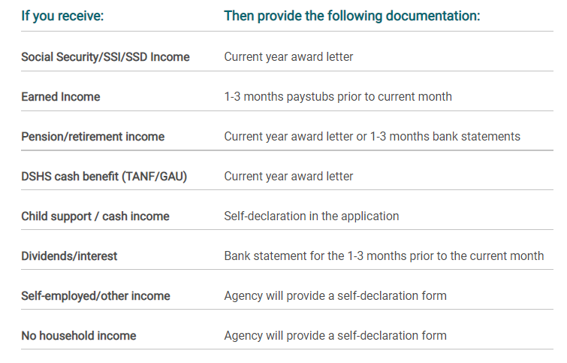
Step 2:
Documents
Photo ID
Income documentation or self declaration online.

Slide 7
Step 3:
Apply online or call your local agency
The PSE HELP and LIHEAP program is administered through county agencies. Contact your local agency to see if you qualify and to apply for these assistance programs.
King County | Tel
Multi-Service Center (for South King) mschelps.org | 253-517-2263
Hopelink (for North and East King) hopelink.org/energy | 425-658-2592
The Byrd Barr Place (Seattle residents) byrdbarrplace.org | 206-486-6828

Slide 8
Federal program assisting with keeping electricity and gas services and avoid disconnection.
Program that requires documentation of your personal information.
What is LIHEAP?
(Low income home energy assistance program)

Slide 9
Step 1:
Call your agency
Call your agency to see if you qualify and to apply for these assistance programs.
King County | Tel
Multi-Service Center (for South King) mschelps.org | 253-517-2263
Hopelink (for North and East King) hopelink.org/energy | 425-658-2592
The Byrd Barr Place (Seattle residents) byrdbarrplace.org | 206-486-6828

Slide 10
What is
The Salvation Army Warm Home Fund?
Provides short-term, emergency bill payment assistance to PSE customers facing financial difficulties.
The funding are contributions from other PSE customers.

Slide 11
STEP 1:
Call your local county agency
The Salvation Army Warm Fund is administered through your local Salvation Army. Contact them to see if you qualify and to apply for these assistance programs.
North King County | Tel
Bellevue | 425-452-7300

Slide 12
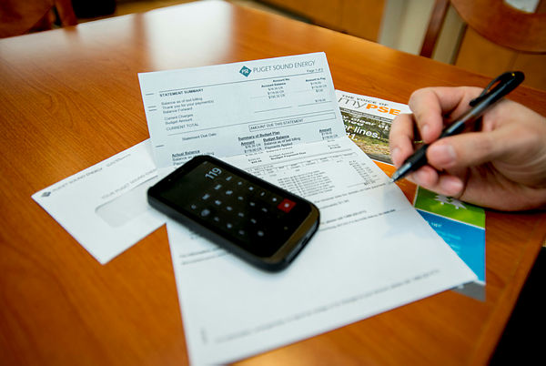
What is Payment Arrangements?
If you don’t qualify for bill assistance you can create a plan so you don’t have to pay your bill all at once.
Creating a plan for you to pay parts of your bill on a weekly, biweekly or monthly plan that work with your individual situation.
Go to www.PSE.com for more info.
Payment arrangements

Slide 13
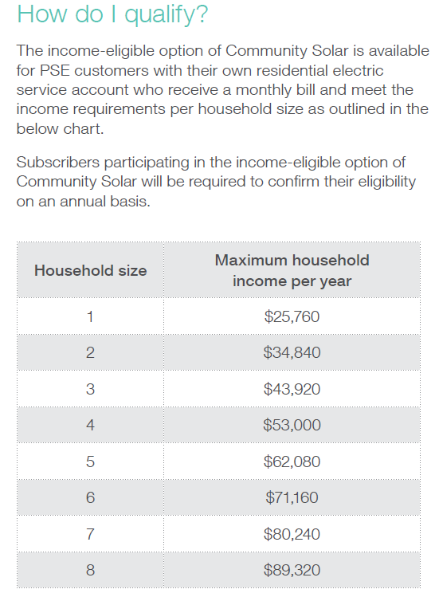
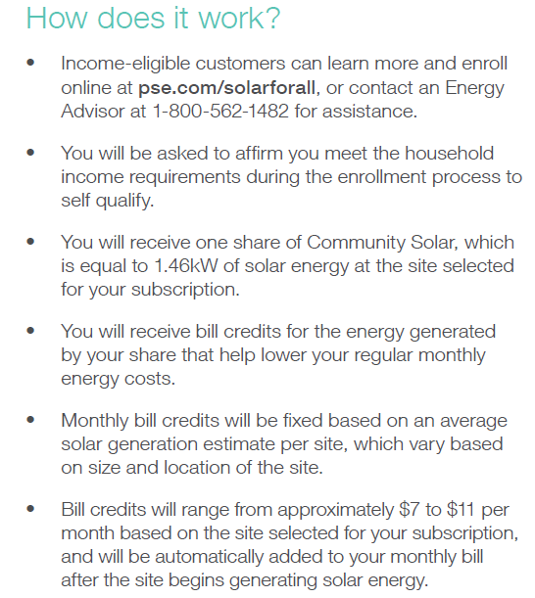
Community Solar
Income Elgible Shares
Notes:
$580,000
235 kilowatts of newly installed solar
240,000 kilowatts per hour saved

Slide 14
Examples of how we can show up
Presentations for staff and clients – in person and virtual.
Workshops showing how to navigate the website, how to apply and set up a PSE account online.
Tabling at events and gatherings.
Facebook live events, radio and podcast.
Collateral distribution in person or electronically.
Newsletter, e-mail blast, social media.
Open for suggestions!

Slide 15
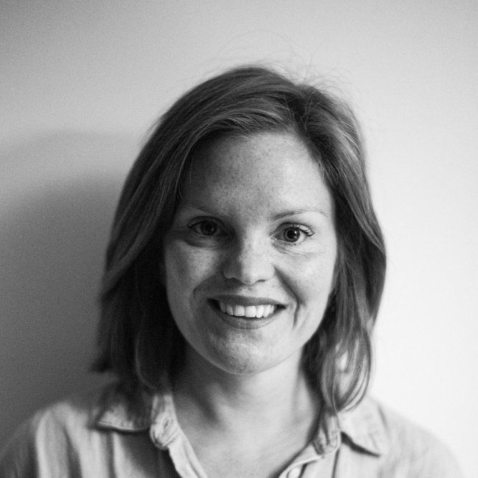
Contacts/Info
Liv : liv.terueljohannesson@pse.com
Website : WWW.PSE.COM
Energy Adviser : 1-800-562-1482
Liv Teruel Johannesson
Outreach Manager King County

