Slide 1
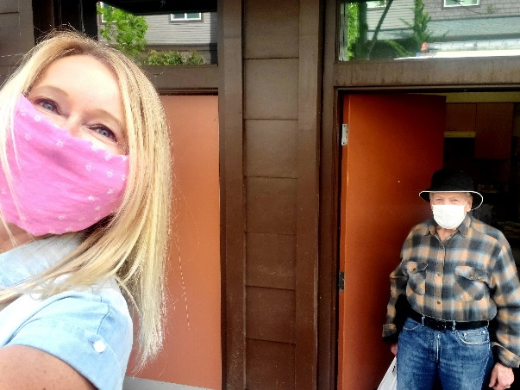
Issaquah Noursing Network May 17, 2022

Slide 2
Our History, Our Belief…
Founded in 1997- grant from Robert Wood Johnson Foundation for “Faith in Action” program.
2008 became a 501c3
2011 name changed to Eastside Friends of Seniors
An unwavering commitment to helping seniors in need, with volunteerism at the core.
We believe one of the most telling ways a
community shows what it values is how it
cares for it’s elderly citizens and their health
and well-being.
This belief drives our mission.

Slide 3
Our Mission
Provide volunteer-based services to older adults facing the challenges of aging

Slide 4
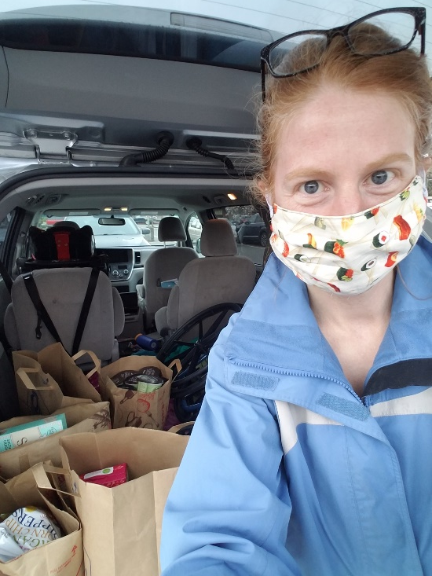
About
At EFS, we are about Community…”Neighbor helping Neighbor.”
We are the matchmaker -- bringing together seniors in need with local volunteers who wish to help with transportation, housekeeping, handyman and yard chores, friendly visiting, and referrals.

Slide 5
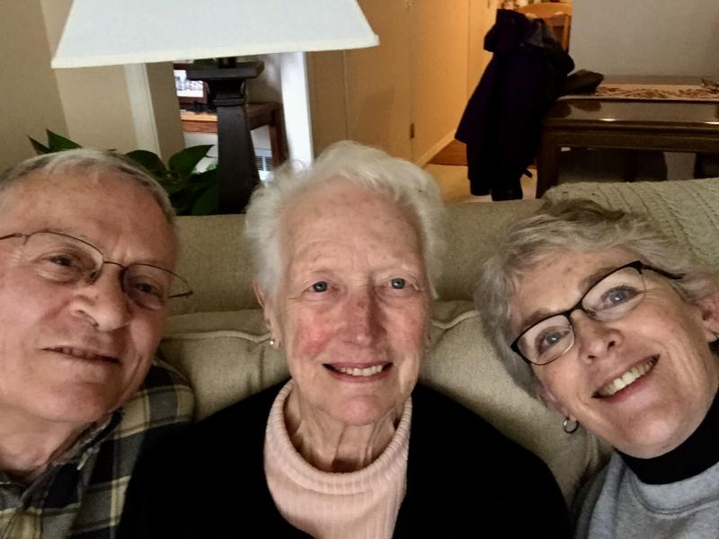
who we serve
Age 60+
Average age is 85
Reside in the greater Issaquah or Sammamish area
Have a need we can meet

Slide 6
who we serve
Roughly 2/3 of our clients come from Issaquah
Roughly 1/3 of our clients come from Sammamish
Roughly 1/3 of our volunteers are from Issaquah
Roughly 2/3 of our volunteers are from Sammamish

Slide 7
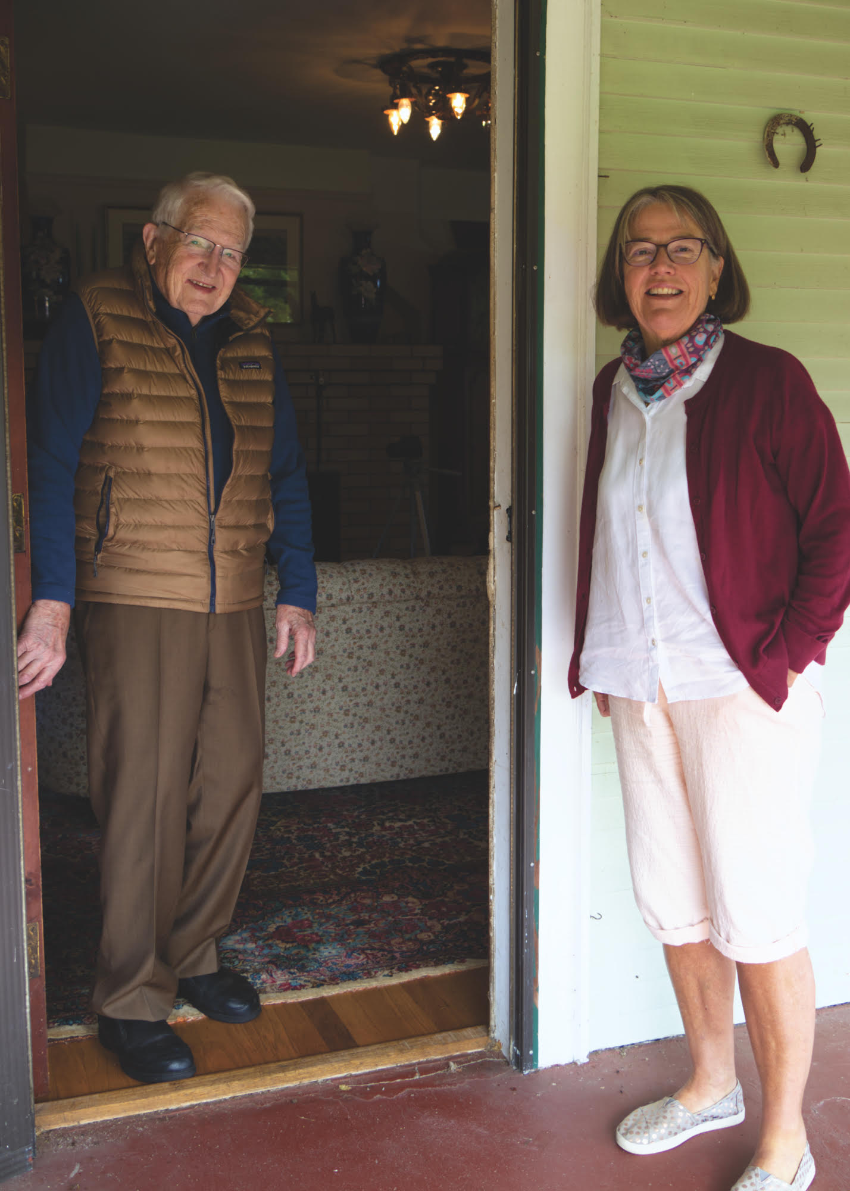
The Growing Need
One of the fastest growing age segments
Most seniors–82%–want to age in place at home, even when they know they need extra help.
Average cost of in-home services is $35/hour
Typical amount spent for our level/kinds of services: over $10,000 per year
Notes:
Age 65 and older make up 13% of the total population

Slide 8
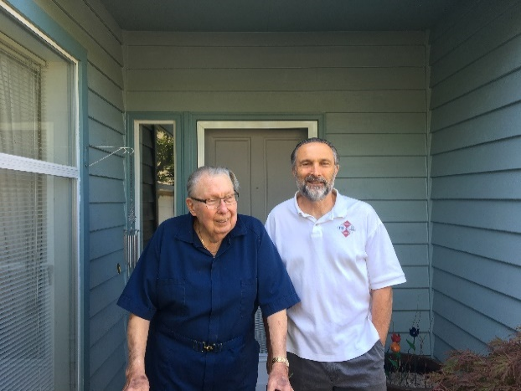
What we Do
We deliver five key services
All services are Free
All services are personalized
EFS meets all clients and gets to know them
EFS trains and screens all volunteers and gets to know them
Personalized approach ensures our professional staff can carefully match clients and volunteers.

Slide 9
What We Do
Transportation
Volunteers give rides to medical appointments – a door-through-the-door service.

Slide 10
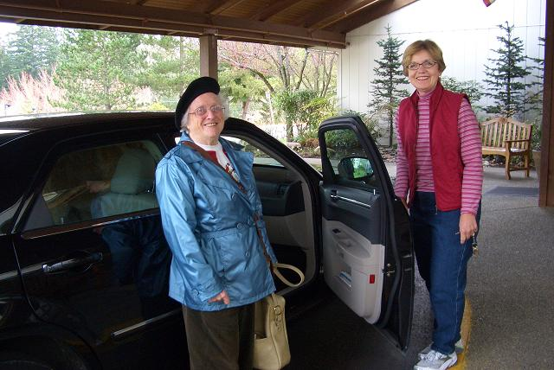
What We Do
Shopping and Errands
May include help navigating the store, putting things away, as needed. During the pandemic we added shopping for clients.

Slide 11
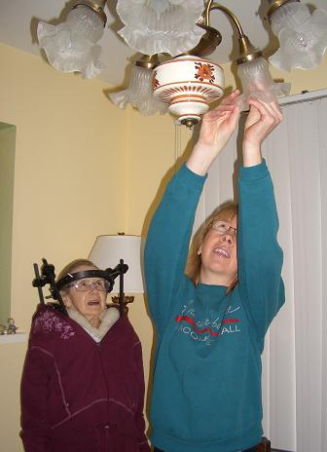
What We Do
Home Services
Our volunteers help with lite house-keeping, handyman tasks, and yard work

Slide 12
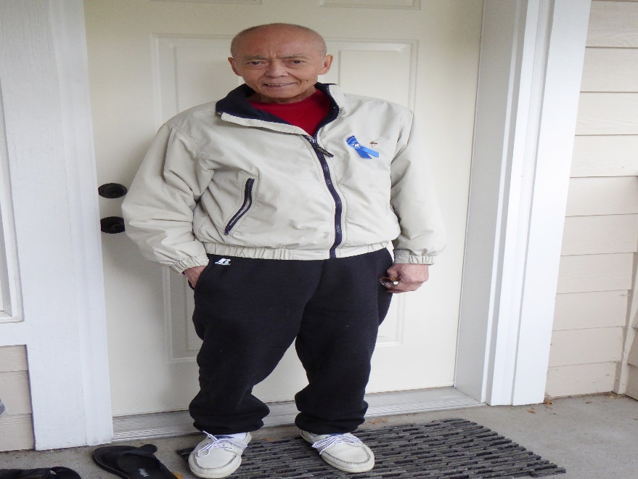
What We Do
Social Support
We bring people together for visiting. In March of 2020 we added a telephone “Buddy” program.
An Eastside Friends of Seniors volunteer is a friendly face in the community.

Slide 13
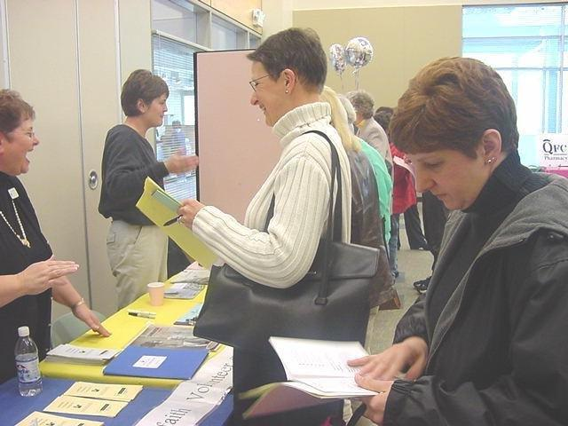
What We Do
Information and Referrals
Information about other community resources that can help
Expertise on the challenges of Aging in Place

Slide 14
COVID 19
How we support our clients!
300+ calls to current and former clients
Updated policies to keep volunteers and clients safe
Transportation to critical appointments
Shopping with porch delivery
Friendly visiting with Telephone Buddies
Assistance making vaccination appointments and ordering home COVID tests
Care packages
Result = 0 clients with COVID!!

Slide 15
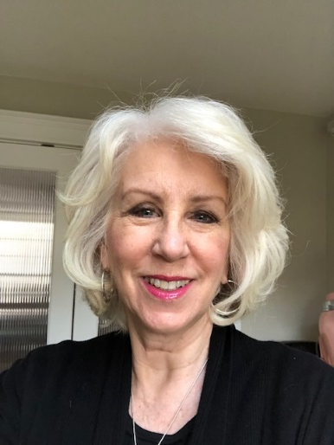
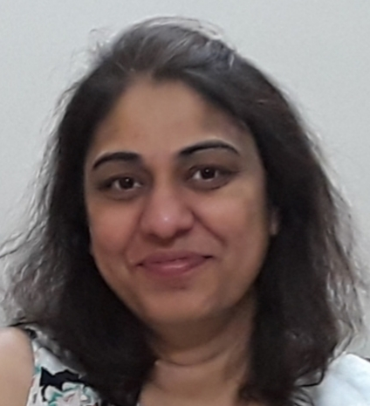
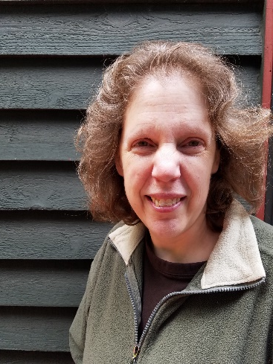
Our Staff
Linda Woodall, Executive Director
Laurie Gillen, Client Services
Jill Coslett, Administrative
Pooja Deshmuhk, Data support
Lisa Varner, Volunteer Coordinator

Slide 16
How we do the work
Becoming a client
Phone intake to determine if appropriate: location and/or needs
Home assessment
Connect with services
One time services
Match for ongoing services
Becoming a volunteer:
Most fill out interest form on website
Volunteer Coordinator follows up with email and next steps
Interview
Orientation
Background checks
Criminal
Sex offender
Driving record

Slide 17
how we fund the work
2022 Budget $233,000
Donations (not associated with fundraising events) 15%
Grants from local government 15%
Grants from foundations, congregations service organizations 28%
Fundraising events 42%

Slide 18
Our Vision for the Eastside
Seniors connected to the community
An end to isolation and loneliness

Slide 19
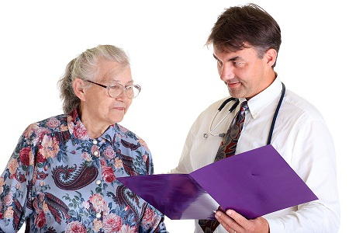
Our Vision for the Eastside
Seniors in better physical and mental health
Our clients receive rides to the doctor to ensure they get the care they need.

Slide 20
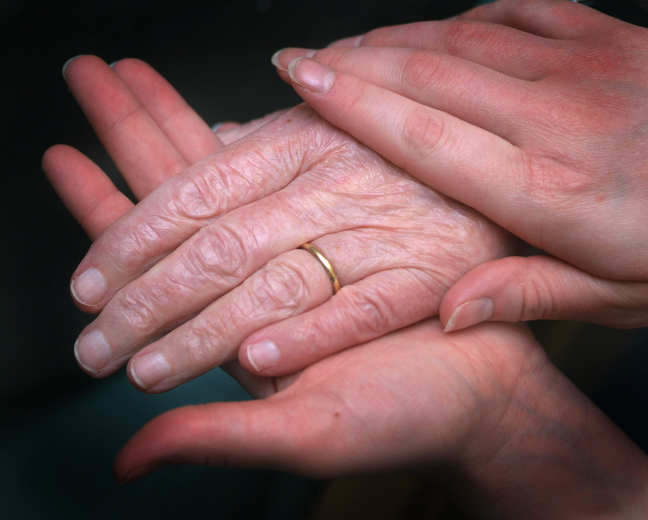
Our Vision for our Seniors
Independent, dignified and engaged older adults.
It isn’t just the elderly who benefit – all of us gain

Slide 21
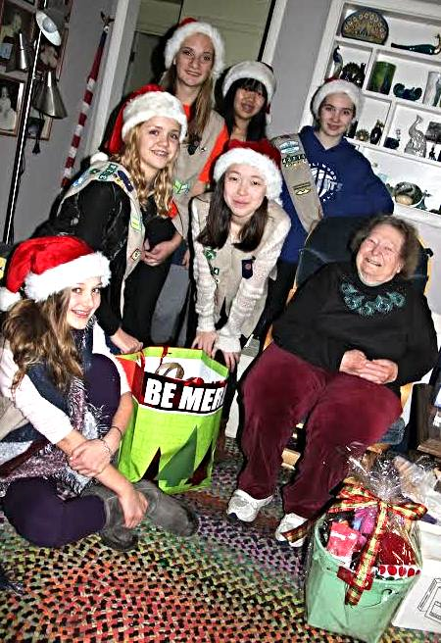
Together We Change Lives!
Volunteer - you choose how and when!
Lend your expertise!
Make a donation - we run a tight ship, but even a sail boat needs more than air to sail.
Attend our fundraisers!
SUDS for Seniors June 20
Aged to Perfection Nov 10
Tells 6 friends about us!
Contact us at 425-369-9120

Slide 22
SUDS for Seniors!

Slide 23
Thank you!
We look forward to working with you to make a stronger organization for the benefit of seniors on the Eastside.
www.eastsidefriendsofseniors.org

