Slide 1
Connect2 Community Network

Slide 2
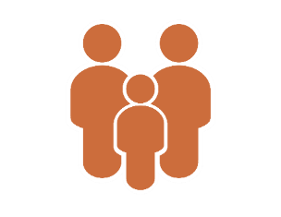
HealthierHere
Who we are:
Nonprofit, cross-sector partnership
27-seat, multi-stakeholder Board
Contracted Accountable Community of Health (ACH) for King County, WA
What we do:
Bridge Silos to Drive System Change
Convene
Collaborate
Improve Health
Equity & Reduce
Disparities
Innovate
2
Equity | Community | Partnership | Innovation | Results
Notes:
We envision a system that is connected, collaborating together to coordinate care and services…. that no matter where people enter, they get connected to the right care in the right setting at the right time.
We know that an essential element to achieving this vision, that many of you helped us create in 2019, is having a way to easily exchange information and coordinate services – a Community Information Exchange.
One of the core principles that emerged early on from this collaborative effort was the need for a unified network across all health and human services organizations. The network would need to have both universal access and interoperability between existing networks and multiple technology platforms.
Second, and equally important, it needed to be locally owned and managed collaboratively by the community – not by any one organization, platform or group. Similar to a public utility, it should be governed by and serve the needs of the entire community.

Slide 3
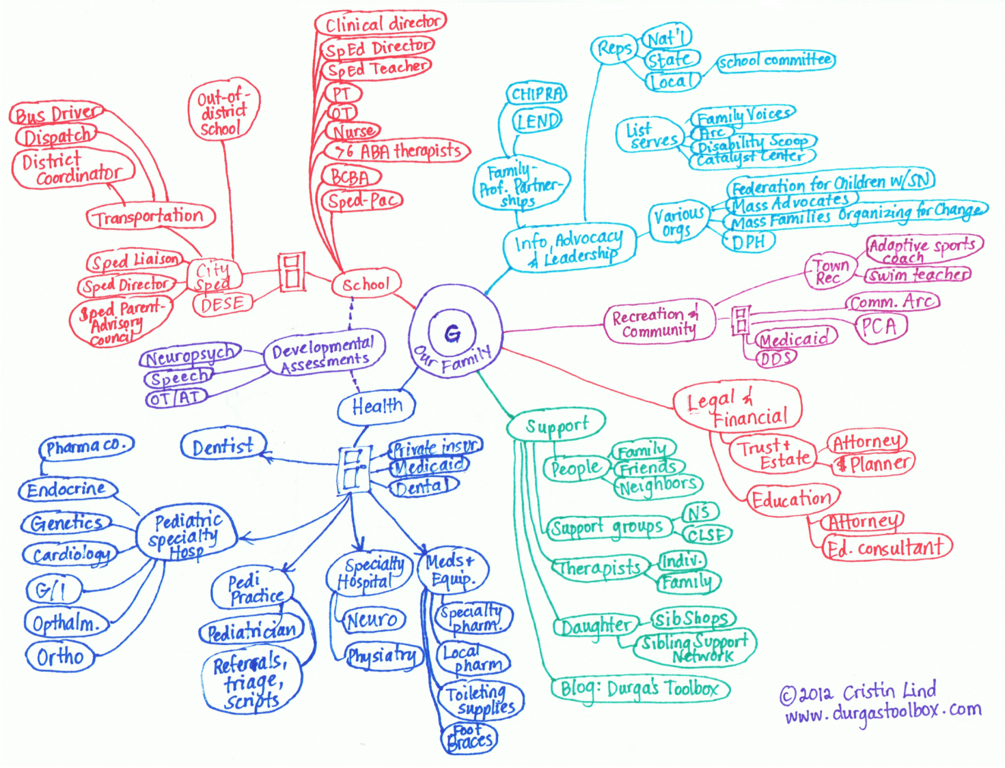
Our systems of care are fragmented
Individuals and families are required to navigate multiple, disconnected systems for support
Social service organizations and providers are not always connected and have access to information
Individuals face systemic barriers and our community faces gaps in resources that lead to health disparities
3
Notes:
As we know, we have a great many resources in King County, but our systems of care are fragmented. Individuals and families in King County
There are many great organizations that provide much-needed services that may be able to help you. But, because they are disconnected from each other, with no easy way to collaborate, if it difficult to get the care and supports you need to be and stay healthy.
We envision a system that is connected, collaborating together to coordinate care and services…. that no matter where people enter, they get connected to the right care in the right setting at the right time.
We know that an essential element to achieving this vision, that many of you helped us create in 2019, is having a way to easily exchange information and coordinate services – a Community Information Exchange.
One of the core principles that emerged early on from this collaborative effort was the need for a unified network across all health and human services organizations. The network would need to have both universal access and interoperability between existing networks and multiple technology platforms.
Second, and equally important, it needed to be locally owned and managed collaboratively by the community – not by any one organization, platform or group. Similar to a public utility, it should be governed by and serve the needs of the entire community.

Slide 4
Community Information Exchange
Connect2 Community Network
Equity and community-focused
Community co-designed
Unified and interoperable
Community-led governance structure

Slide 5
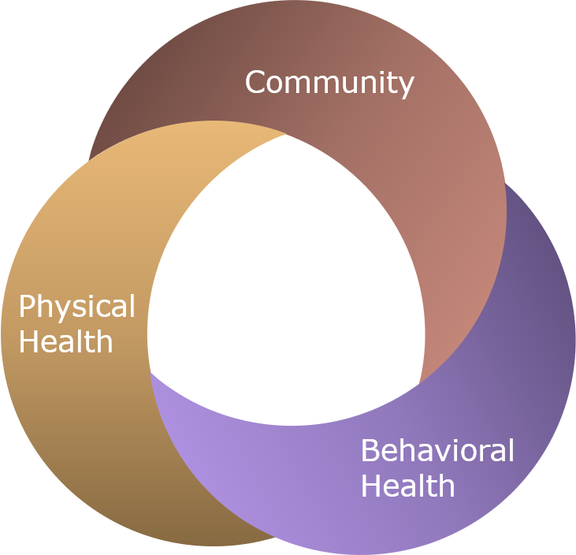
Our Vision: Co-Create a Connected System of Whole-Person Care
d
d
d
d
d
Strengthen the coordination of care for those in need by connecting people, service organizations, and community partners more quickly and more effectively – resulting in a healthier, more equitable community for all.
5
Notes:
We envision a system that is connected, collaborating together to coordinate care and services…. that no matter where people enter, they get connected to the right care in the right setting at the right time.
We know that an essential element to achieving this vision, that many of you helped us create in 2019, is having a way to easily exchange information and coordinate services – a Community Information Exchange.
One of the core principles that emerged early on from this collaborative effort was the need for a unified network across all health and human services organizations. The network would need to have both universal access and interoperability between existing networks and multiple technology platforms.
Second, and equally important, it needed to be locally owned and managed collaboratively by the community – not by any one organization, platform or group. Similar to a public utility, it should be governed by and serve the needs of the entire community.

Slide 6
Co-Design
d
d
d
d
d
2019: Hosted co-design collaboratives for organizations in King County to help design the Community Information Exchange
2020: Established workgroups for organizations to have an ongoing space to participate in co-design
2021: Launched consumer engagement process to gather input directly from community members

Slide 7
Functionality Overview
d
d
d
d
d
Bi-Directional Referrals
Longitudinal Record
Data integration & Inter-operability
Care Team Info
Shared Care Planning
Resource Database
Client Access

Slide 8
Technology Architecture
d
d
d
d
d
Unified Network
Tech Platform
Recipient
Unified Network Infrastructure
Tech Platform
Shared Data
Shared Access
Tech Platform
Client Index
Resource Database
Care Team
Longitudinal Record
Tech Platform
Tech Platform
Referring User

Slide 9
Protecting and Maintaining Privacy
d
d
d
d
d
Client Authorization to Disclose
The success of the Connect2 Community Network hinges on the trust we have with providers and the trust they have with community members. The Privacy Framework is how we protect and maintain that trust.
Privacy Policy
Privacy Framework
Participation Agreement
Data Use Agreement
Business Associate Agreement

Slide 10
Connect2 Community Network Governance
d
d
d
d
d
Advisory Group
Network Partner Workgroup
Unite Washington Workgroup
Other Workgroups as needed
Legal, Data & Technology Workgroup
Develop recommendations on the design and implementation of the network
Develop recommendations on privacy and technology
Support partner participation and the growth of the Unite Us network
Examples:
Policy
Population-specific
Service type

Slide 11
Get Involved
Sign up to our email list and stay updated on our progress and events
Connect with partner organizations at workgroup meetings and participate in design and implementation
Consider joining Unite Us to send a receive bi-directional closed loop referrals
Help us build awareness and invite us to share information with your organization/coalitions
Notes:
Consider joining Unite Us technology
Join community meetings to experience the Connect2 Community Network
Help us build awareness about the C2C Network

