Slide 1
Behavioral Health and Homeless Outreach Program
Caelann Wood, Behavioral Health Coordinator
Monica Negrila, Human Services Manager

Slide 2
Background
2020 New Approach to Human Services
2020 Homeless Outreach program launched
2021 Needs Assessment & Human Services Strategic Plan
2022 Strategic Investments

Slide 3
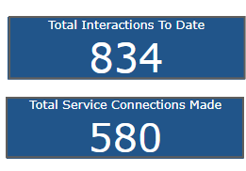
Program Overview
The Behavioral Health Program is a coordinated effort between the Human Services Division and the Police Department. | Data Updates
Goals | Support the work of the Police Department with cases involving behavioral health crises, Divert clients from the Criminal Justice System by decreasing the number of repeat calls in need of behavioral health services. Help residents access mental health and/or substance use services along with related support services including long term support, transportation, health insurance, basic needs, vocational and educational services.
Program Launch | Launched in June of 2021, program participation is voluntary and free of charge.
Referral Sources | Police, Jail, Municipal Court, City Departments Community referrals have been paused due to staff capacity
Number of Referrals | 223 unduplicated referrals
Metrics | Homeless Outreach Dashboard Launched in April; Behavioral Health Dashboard in progress

Slide 5
Barriers to Behavioral Health Services
Technology
Phone/Computer Access
Technology literacy
Transportation
Majority of services are outside of Issaquah
Lack of public transit or transportation services
Time
Staff Shortages
Funding limitations
Scheduling

Slide 6
Questions & Discussion
Monica Negrila monican@issaquahwa.gov
(425) 837-3416
Caelann Wood
caelannw@issaquahwa.gov
(425) 301-2934

