Slide 1
Food and Nutrition Services

Slide 2
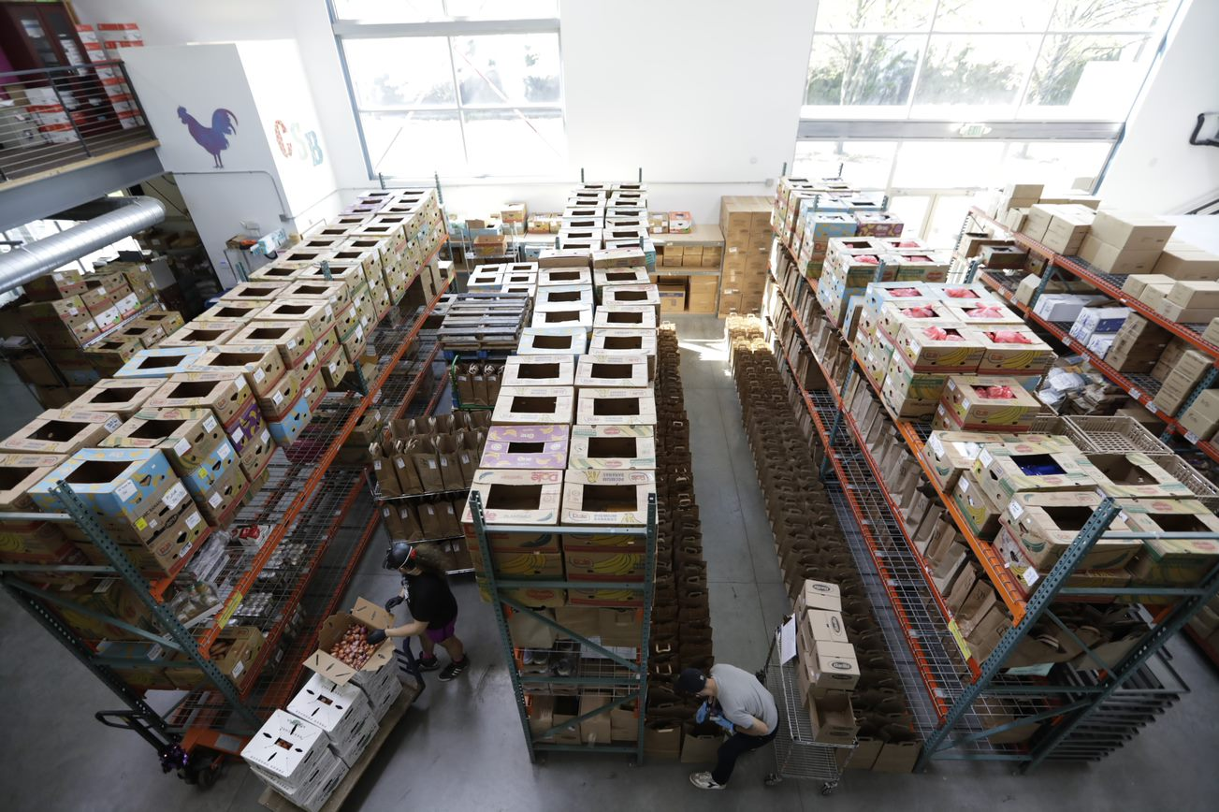
Overview
Who we are
What we do
Who we serve
How to refer

Slide 3
Our Mission
Mission: We remove barriers to health with relentless compassion so that no one faces illness and injustice alone
Legacy: We have always fought for those living with HIV and we always will
Vision: Health For All

Slide 4
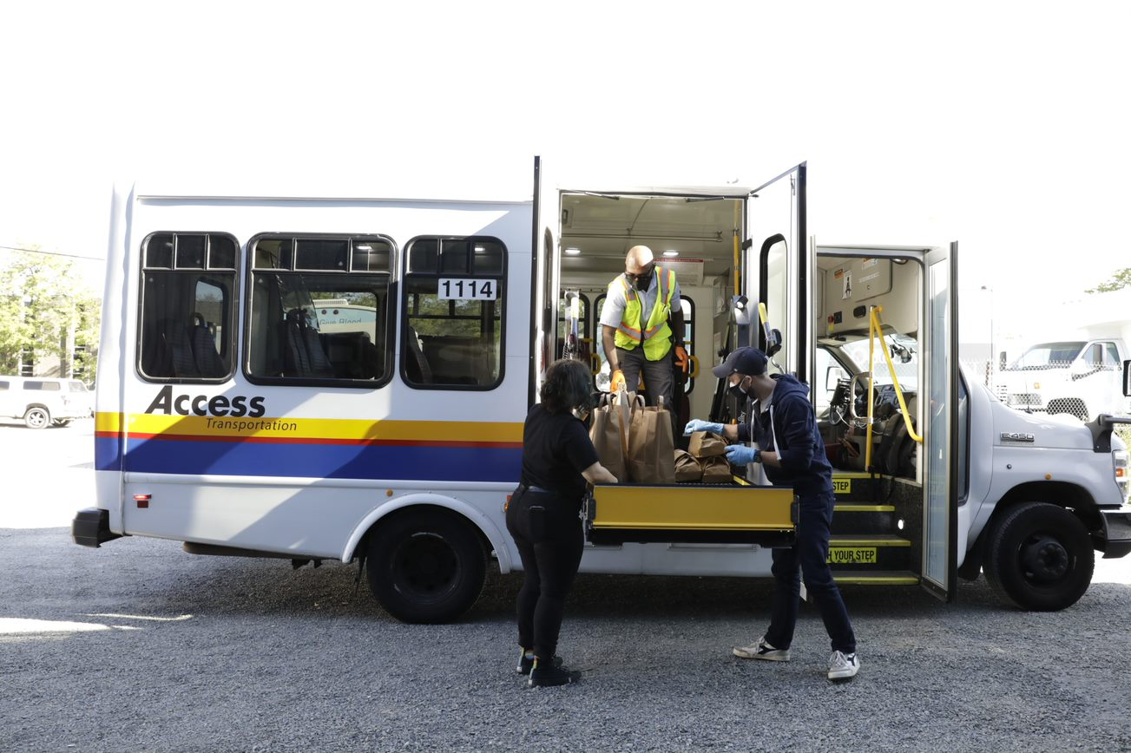
WHAT WE DO
Chicken Soup Brigade works to improve the nutritional health of adults and families living with chronic health conditions.
We believe Food is Medicine and has the power to reduce symptoms of many illnesses. Food is a tool of prevention.
We prioritize services for those facing illness and injustice in order to improve their overall well-being and their health outcomes.

Slide 5
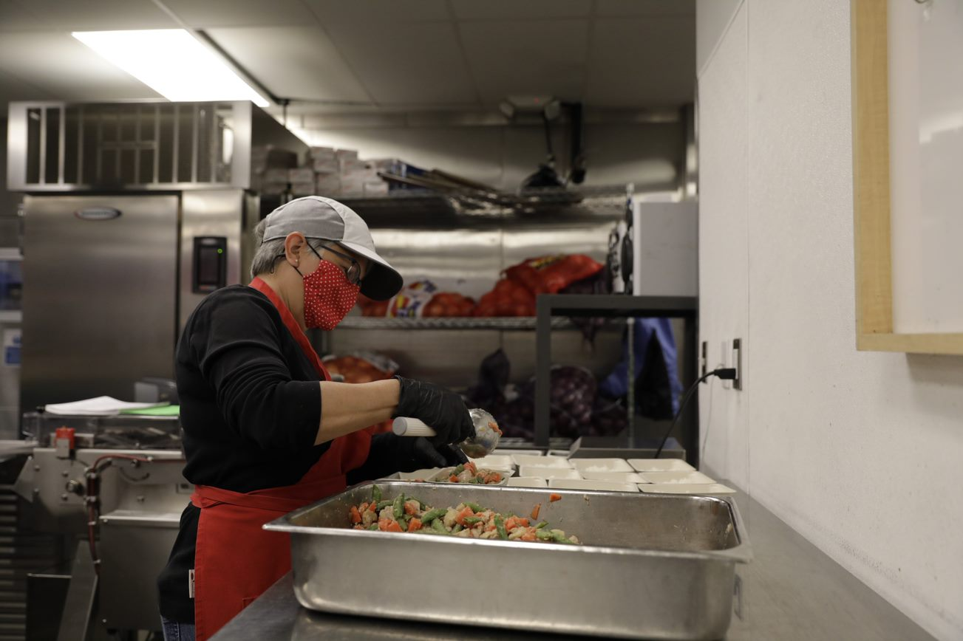
OUR SERVICES
Home Delivered Meals
Made in-house, from scratch, using whole food ingredients
Frozen and delivered to client’s homes
We offer 7 or 14 meals per week
Follow nutrition guidelines established by the American Heart Association and the American Diabetes Association
11 specialized meal types: Healthy Standard, Easy Digestion, No Gluten/No Dairy, Vegetarian, Dialysis Care, No Pork/No Beef, No Fish, No Nuts. All meals available soft.

Slide 6
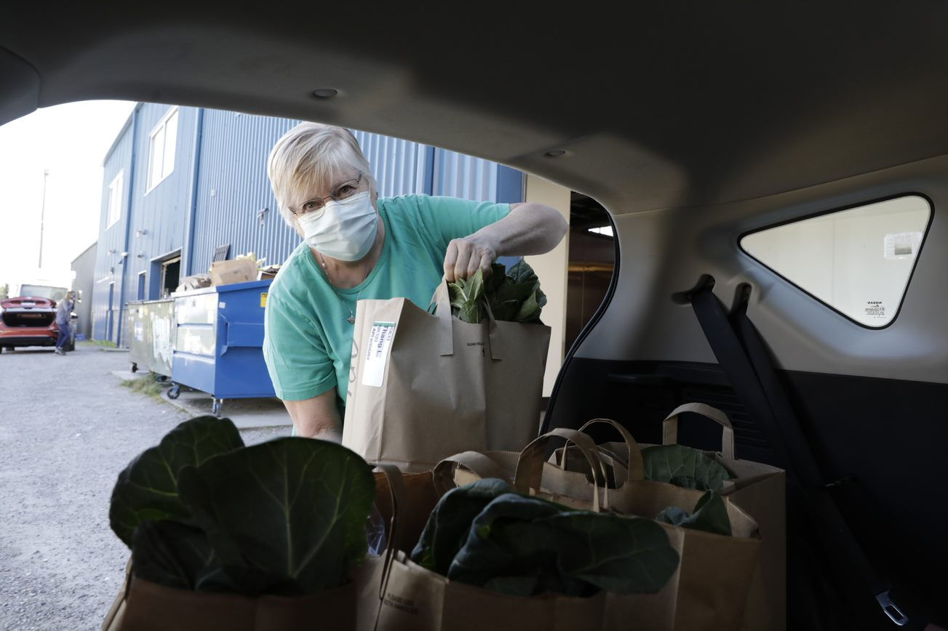
OUR SERVICES
Groceries
Bags of groceries have enough food from each food group to make 7 nutritious meals
Follow nutrition guidelines established by the American Heart Association and the American Diabetes Association
Our Grocery Bag Options: Healthy Standard, Low Cook, API, Latinx, East African

Slide 7
OUR SERVICES
Nutrition Counseling
Team of RDNs who provide MNT using client centered strategies, thorough assessment of nutritional health and dietary needs; use motivational interviewing techniques
RDN team supports clients through education and guidance on practical cooking skills, how to choose the best foods to support their health condition

Slide 8
OUR SERVICES
Nutrition Classes
Community Nutritionist provides virtual classes in collaboration with partner agencies
Classes include cooking skills and nutrition education
Participants receive a bag of groceries with recipe ingredients each week

Slide 9
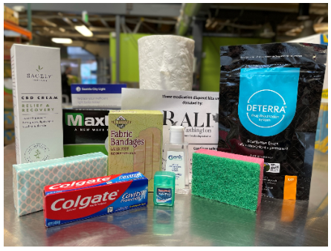
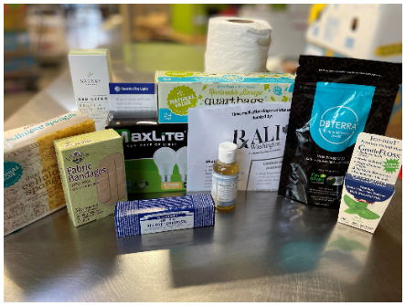
OUR SERVICES
Home Essential Kits
Include home cleaning supplies, hygiene, safety and sanitation products

Slide 10
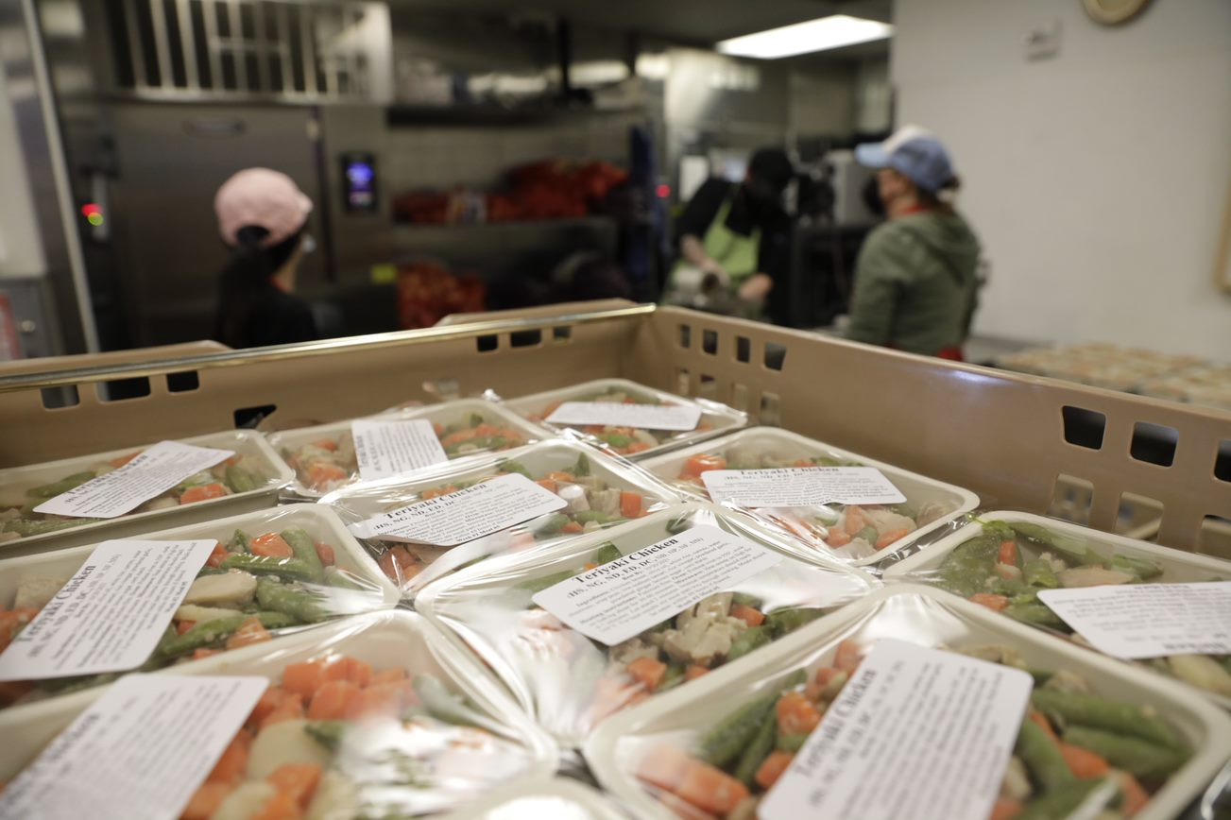
What makes us unique?
All of our programs are free of charge
Medically tailored meals
Culturally specific groceries and meals
Meals for caretakers

Slide 11
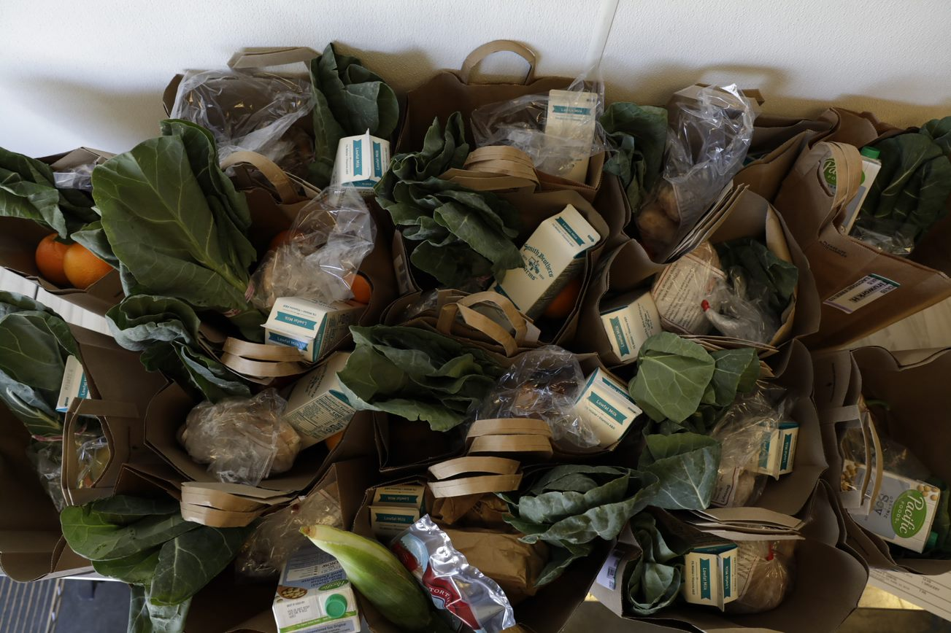
Eligibility Criteria
Over 18
Living in King, Snohomish, or Island County
Homebound
Monthly income less than 200% of the FPL

Slide 12
What is the process?
Referral
Submit an application via email, fax or paper
-OR-
Call the Client Services phone line to complete an application over the phone
Intake and Enrollment
Client Services staff either complete the intake and enrollment immediately or call the client back to complete the intake and enrollment
Nutrition Screening
Enrollment includes a nutrition screening process in order to determine risk; referrals are prioritized accordingly by the nutrition team
Nutrition Assessment
RDNs call clients to complete a comprehensive assessment over the phone and provide ongoing counseling as needed
Annual Recertification
Clients information is reviewed annually

Slide 13
How to reach us
Client Services Phone Line: 206-957-1686
Client Services Email: foodservices@lifelong.org

Slide 14
OUR COVID-19 Response
We are currently taking every precaution to keep our staff, volunteers and clients as safe as possible, while continuing to provide the vitally important food and nutrition services our communities need most
All intakes and assessments are being done telephonically for the time being
Our Capitol Hill Food and Nutrition Center has closed temporarily until we can re-open safely; all clients are now receiving home delivery

Slide 15
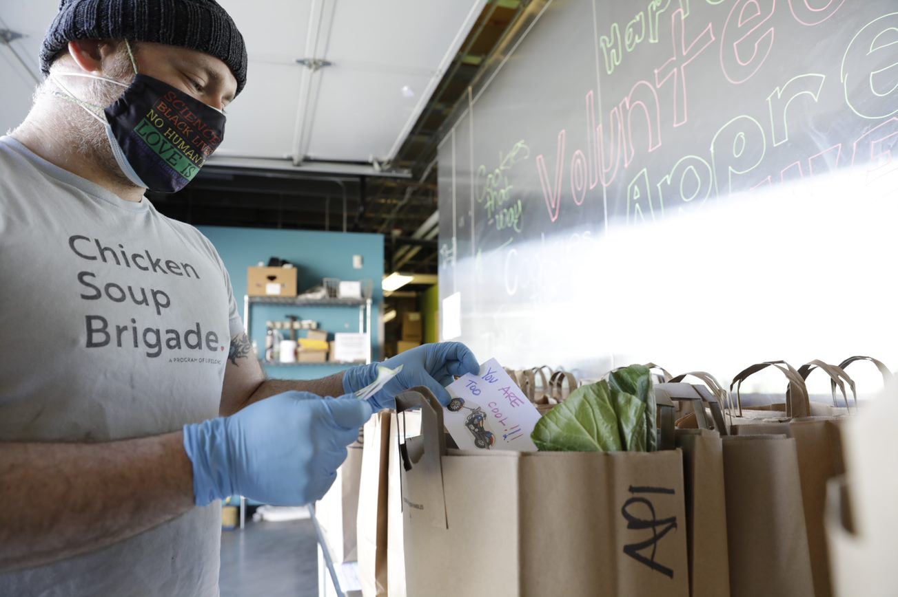
OUR COVID-19 Response
Our distribution policy has changed to a “No Contact” delivery; drivers are using hand sanitizer before and after each delivery, they are not entering client homes and staying 6 feet from clients upon delivery; all drivers must wear masks when making a delivery

Slide 16
WE APPRECIATE your continued partnership!

Slide 17
Thank you
Morgan Feder
Client Services Supervisor
morganf@lifelong.org / 206-957-1686

