Slide 1
Celebrating 20 years working to improve the mental health delivery system and the quality of life for those impacted by mental health conditions through advocacy, community awareness, education and support.

Slide 2
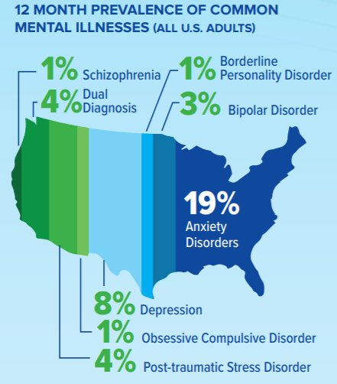
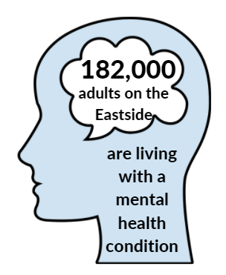
Mental Health by the Numbers
1 in 5
It used to be
U.S. adults experience mental illness
(NAMI, 2021)
The COVID-19 pandemic has doubled this number.

Slide 3
During late June 2020, 40% of U.S. adults reported struggling with mental health or substance use. (CDC, 2020)
Anxiety/Depression Symptoms
Trauma/Stressor-related Disorder Symptoms
Started or Increased Substance Use
Seriously Considered Suicide
0%
10%
20%
30%
40%

Slide 4
NAMI Eastside
Founded in 2001 to serve the needs of those on the Eastside
One of the more than 600 local affiliates of the National Alliance on Mental Illness across the country
One of the 19 NAMI affiliates in the state of Washington

Slide 5
Our Programs & Services
Support groups, classes, and presentations
For individuals living with a mental health condition, for their families, and for the community
Led by trained facilitators who bring their own lived experience to the space
Always free and confidential
You can learn more about our classes at https://nami-eastside.org/education/
and can find our support group schedule at https://nami-eastside.org/online-offerings/

Slide 6
In 2020…
Our support groups, classes, programs, and forums served over 13,000 people.
We educated 6,350 students, families, and school staff about mental health conditions through our NAMI in the Schools presentations.

Slide 7
We look forward to supporting even more individuals and their families in 2021!
Join our e-mailing list to stay up-to-date with upcoming events at http://bit.ly/nes-email
Website: https://nami-eastside.org/
Email: info@nami-eastside.org
Phone: 425.885.6264

